Slide 1

Card-size Reaction Tester
Team Number: 10
Team Members: Xiang Li, Haoyang Han, Tony Tong, James Su, Danny Li
ECE 411 Industry Design

Slide 2
Background
Problem/Need:
Existing devices for reaction and memory testing are either bulky or expensive.
Lack of portable, affordable options for both professionals and casual users.
Motivation:
Offers valuable feedback for athletes, gamers, and drivers.
Improves reflex and memory training in an engaging way.
Existing Alternatives:
Large sport reaction meters.
Costly professional tools.

Slide 3
Our Approach
We set the following goals for the products we designed:
Hardware Goals:
Must be portable.
Must measure reaction times accurately.
Must have a screen to display the score.
Should be user-friendly.
Should initiate a countdown before testing.
Should have a switch to control power on/off.
Should have another function.
May feature an aesthetically designed case.
May use low power.
May have a menu.
Software Goals:
Implement four interactive games using Arduino IDE:
Reaction Game: Measures user reaction times.
Jump Dino: An engaging and fun gameplay experience.
Memory Game: Tests memory retention skills.
Snake Game: A classic game for user entertainment.

Slide 4
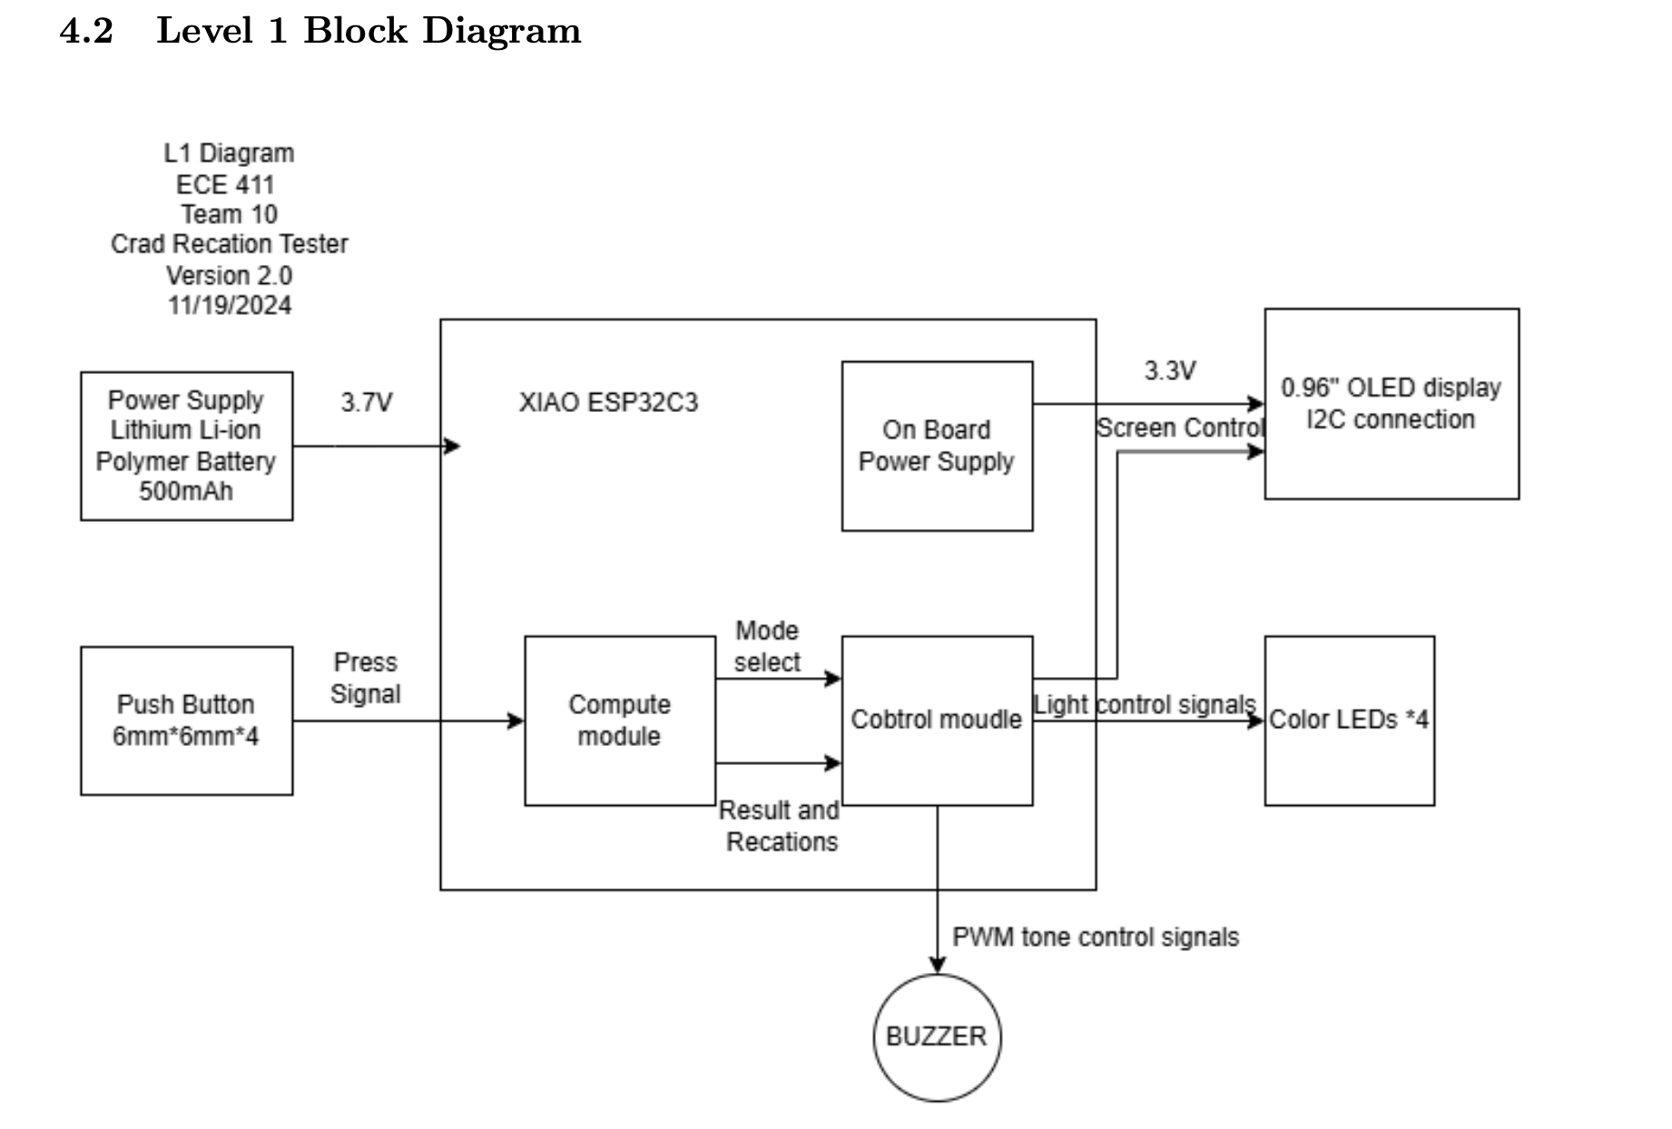
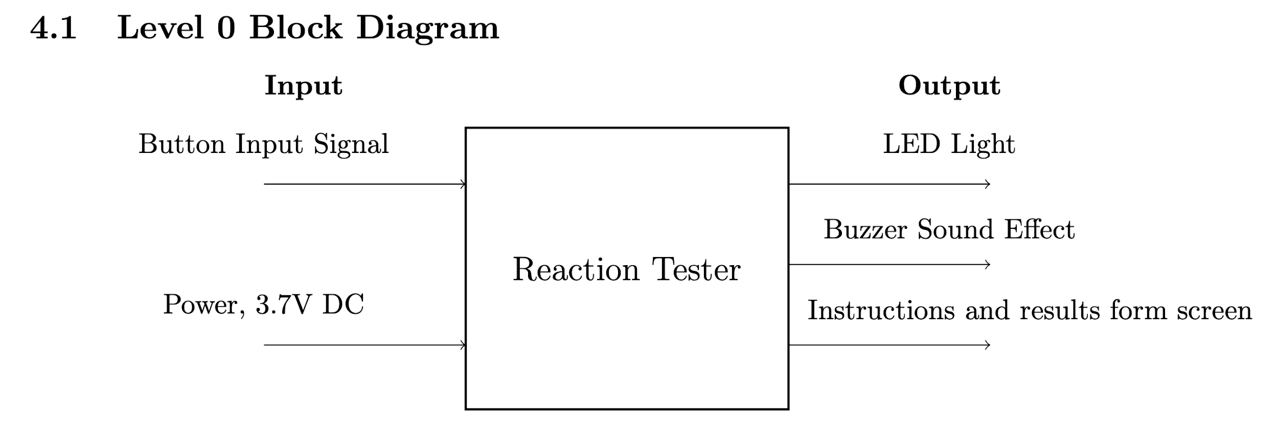
Design Overview
L0 shows the basic input and output of our device, its power will be from a 3.7V Lithium Li-ion Polymer Battery, and the buttons are the main thing the player interacts with.
The LED lights and Data form the screen will give the user a clear guidance about what they are going to do and what they’ll get. The Buzzer is used to add sound effects to make it better.
L1 shows more details about the device, and labels all the function of input and output signals. This device basically receives output from the buttons and shows the results after competition. Note that for the power supply, the controller is connected to a 3.7V battery, but the other components are powered by the board is 3.3V.

Slide 5
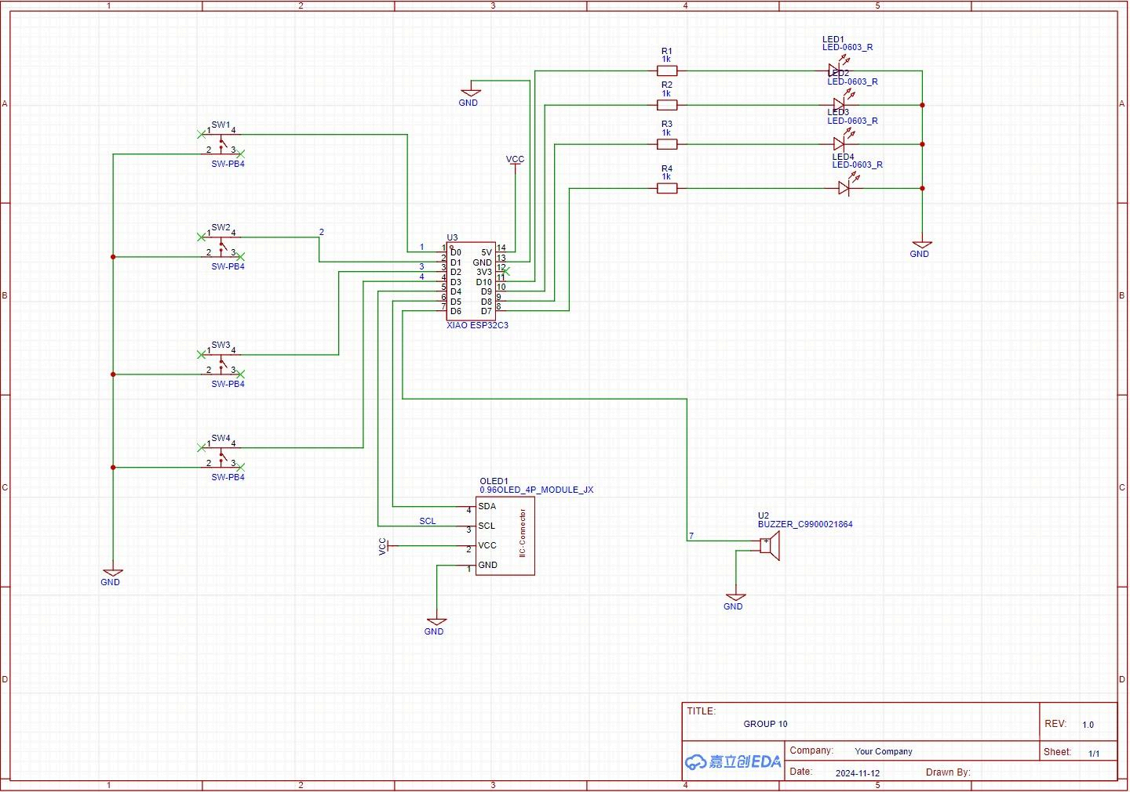
Implementation
Function: A microcontroller reads four switches and responds with LEDs, an optional buzzer, and a display.
Inputs: Four switches connect to input pins. Pressing one changes its pin state.
Outputs: LEDs light up when their switches are pressed. A buzzer and an OLED display can also provide feedback.
Operation: The microcontroller continuously checks switch states and updates indicators accordingly.

Slide 6
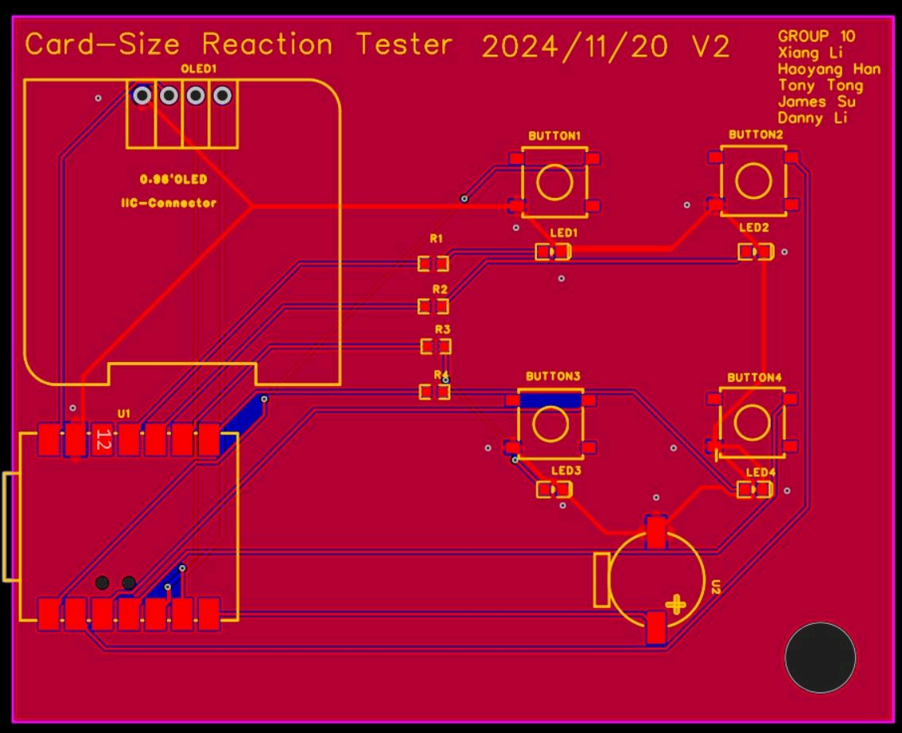
Implementation
A compact PCB integrates four buttons, LEDs, and an OLED display.
The microcontroller reads button presses to measure reaction time and illuminates the corresponding LEDs.
Results are shown on the OLED, providing immediate, visual feedback.

Slide 7
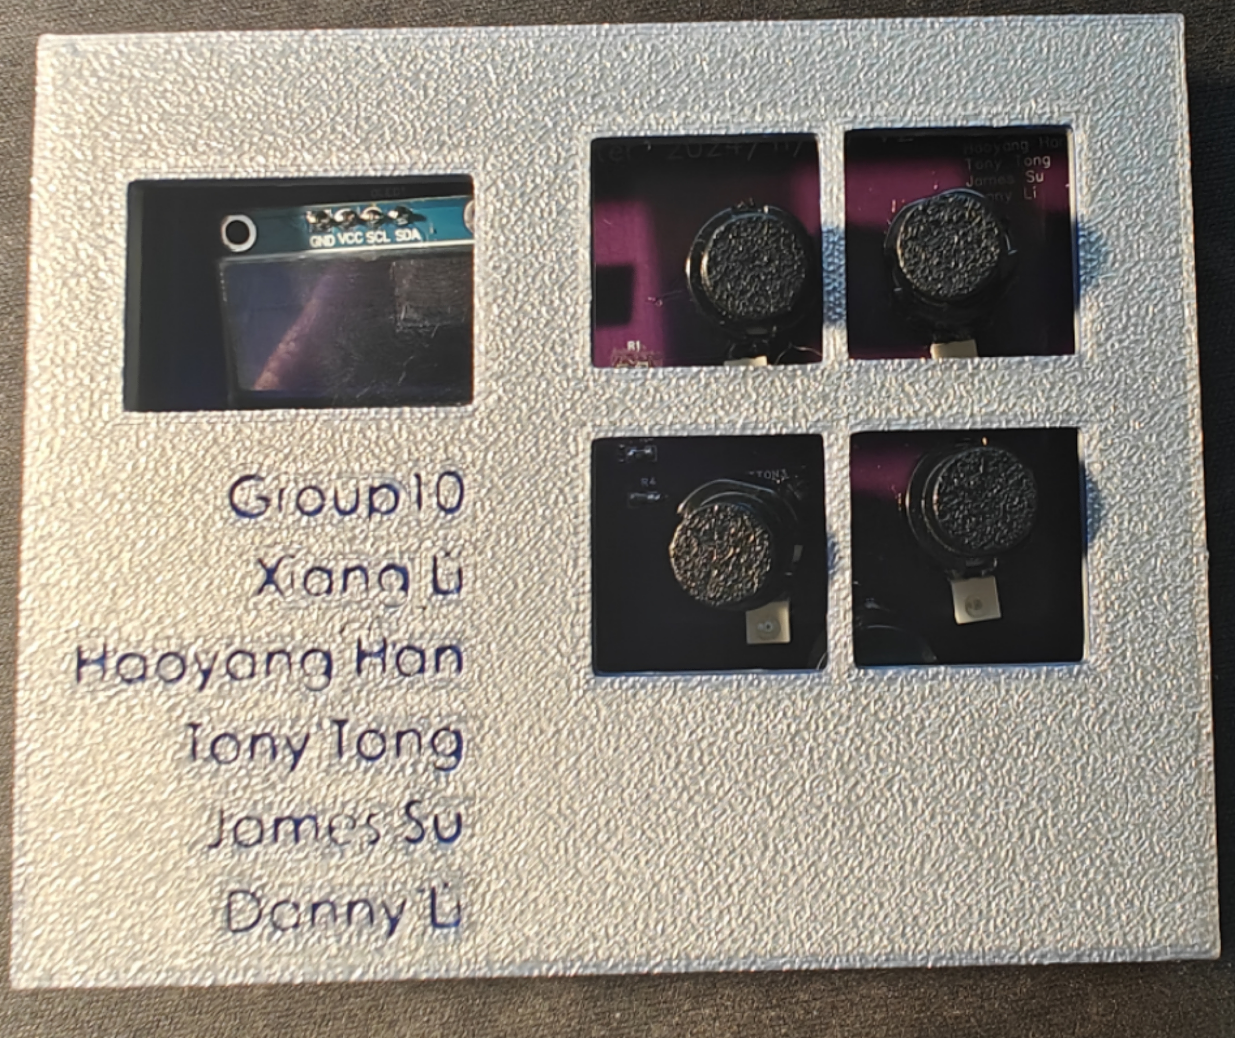
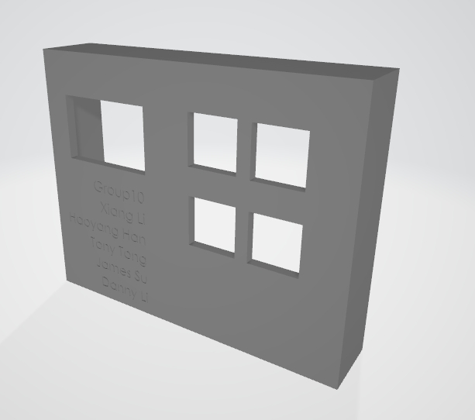
Implementation
In the early stage, sketch drawing and overall appearance and size measurement of the model are carried out.
In the mid-term, digital modeling and structural optimization are carried out.
In the later stage, 3D printing is carried out for physical production.

Slide 8
Code flow
I want to test reaction time
Resources: 4 BUTTONS, 4 LEDs
Reaction Time = The time between See and Click
Add more in the same physical resources
Add more functions:
I need a way to expand
Development a MENU
The Menu is a container, and I can add more Functions
More functions:
Memory Game
Jumping Dino
Snake

Slide 9
Code Overview
Development in Arduino and VS code with Platform IO, but finally Arduino
Main functions
The Menu
Reaction Test
Jumping Dino (Try to copy Chrome Dino game, but end up with a jumping block)
Memory Game
Snake Game
Settings
Miner functions
Display
Buzzer sound
LED lights

Slide 10
IP and Prior Work
IP: MIT license
Learn form https://wiki.seeedstudio.com/XIAO_ESP32C3_Getting_Started/ Getting Started with Seeed Studio XIAO ESP32C3 to start up
Adafruit 1306 Library to drive the OLED display https://github.com/adafruit/Adafruit_SSD1306

Slide 11
Summary of Hardware Test Plan
S T E P | Action | Expected Result | P A S S | F A I L | N / A | Comments
1 | Upload the code to XIAO ESP32C3 | The Screen lights up and shows the welcome Screen. | √ |  |  | The Welcome Screen can be more informative, more than “Welcome”
2 | Click any button to enter the Menu | The output on the Screen moved to MENU | √
3 | Use two buttons as UP and Down | The “cursor “ of the menu should be controlled by the two buttons. | √ |  |  | Later add the background highlight to make it more visible.
4 | Use Button to choose the desired function- Reaction test | The result go into the Reaction Game welcome page | √
5 | Start the game by clicking button | Show the Count Down “3,2,1” | √ |  |  | Later change the size of the numbers.
6 | Push the corresponding button with the light LED | After pushing, the LED is off, and reaction time is recorded. | √
7 | After the number of cycles, show result | The average reaction time shown on Screen | √ |  |  | Make the text size LARGER
8 | Back to MENU, can choose function again | Show the Menu and can interact with it again. | √
 | Overall test result: The Basic function is working as expected, the UI is informative and clear, and can work normally as expected.

Slide 12
Summary of Software Test Plan
TEST | INPUTS | EXPECTED OUTPUTS | P A S S | F A I L | N/A | Comments
1 | In Reaction test, click the Button of the corresponding LED | One LED off, the other ON | √ |  |  | Can have some future improvements
2 | In Reaction test, click the different Button of the corresponding LED | LED still on, hold the state | √
3 | In the memory test, click the button in the right order shown before. | Pass this round, go into the next round. | √
4 | In the memory test, click the button in the different order shown before. | Shown “GAME OVER” | √
 | Overall test result: For Different inputs in different modes, it responds correctly.

Slide 13
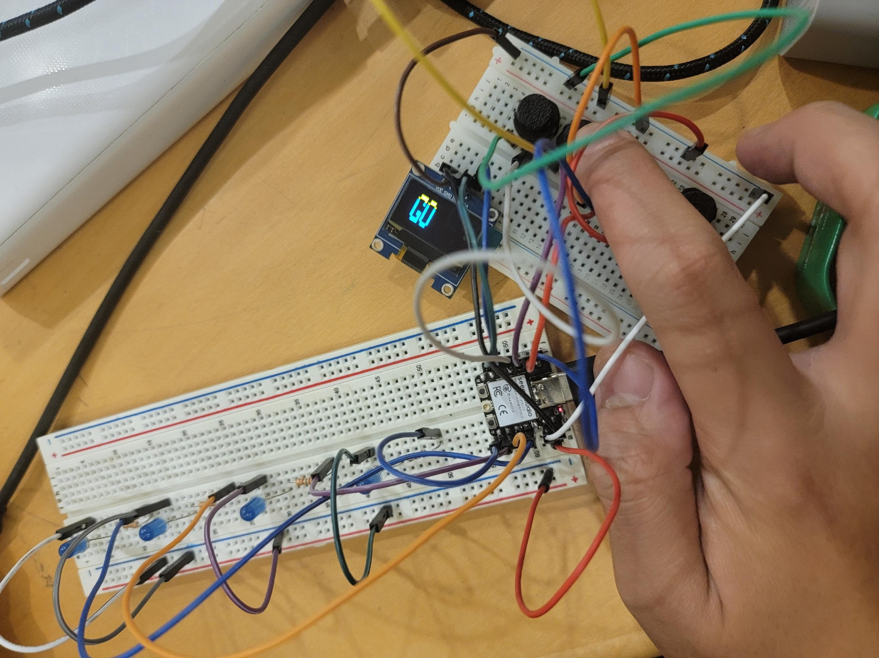
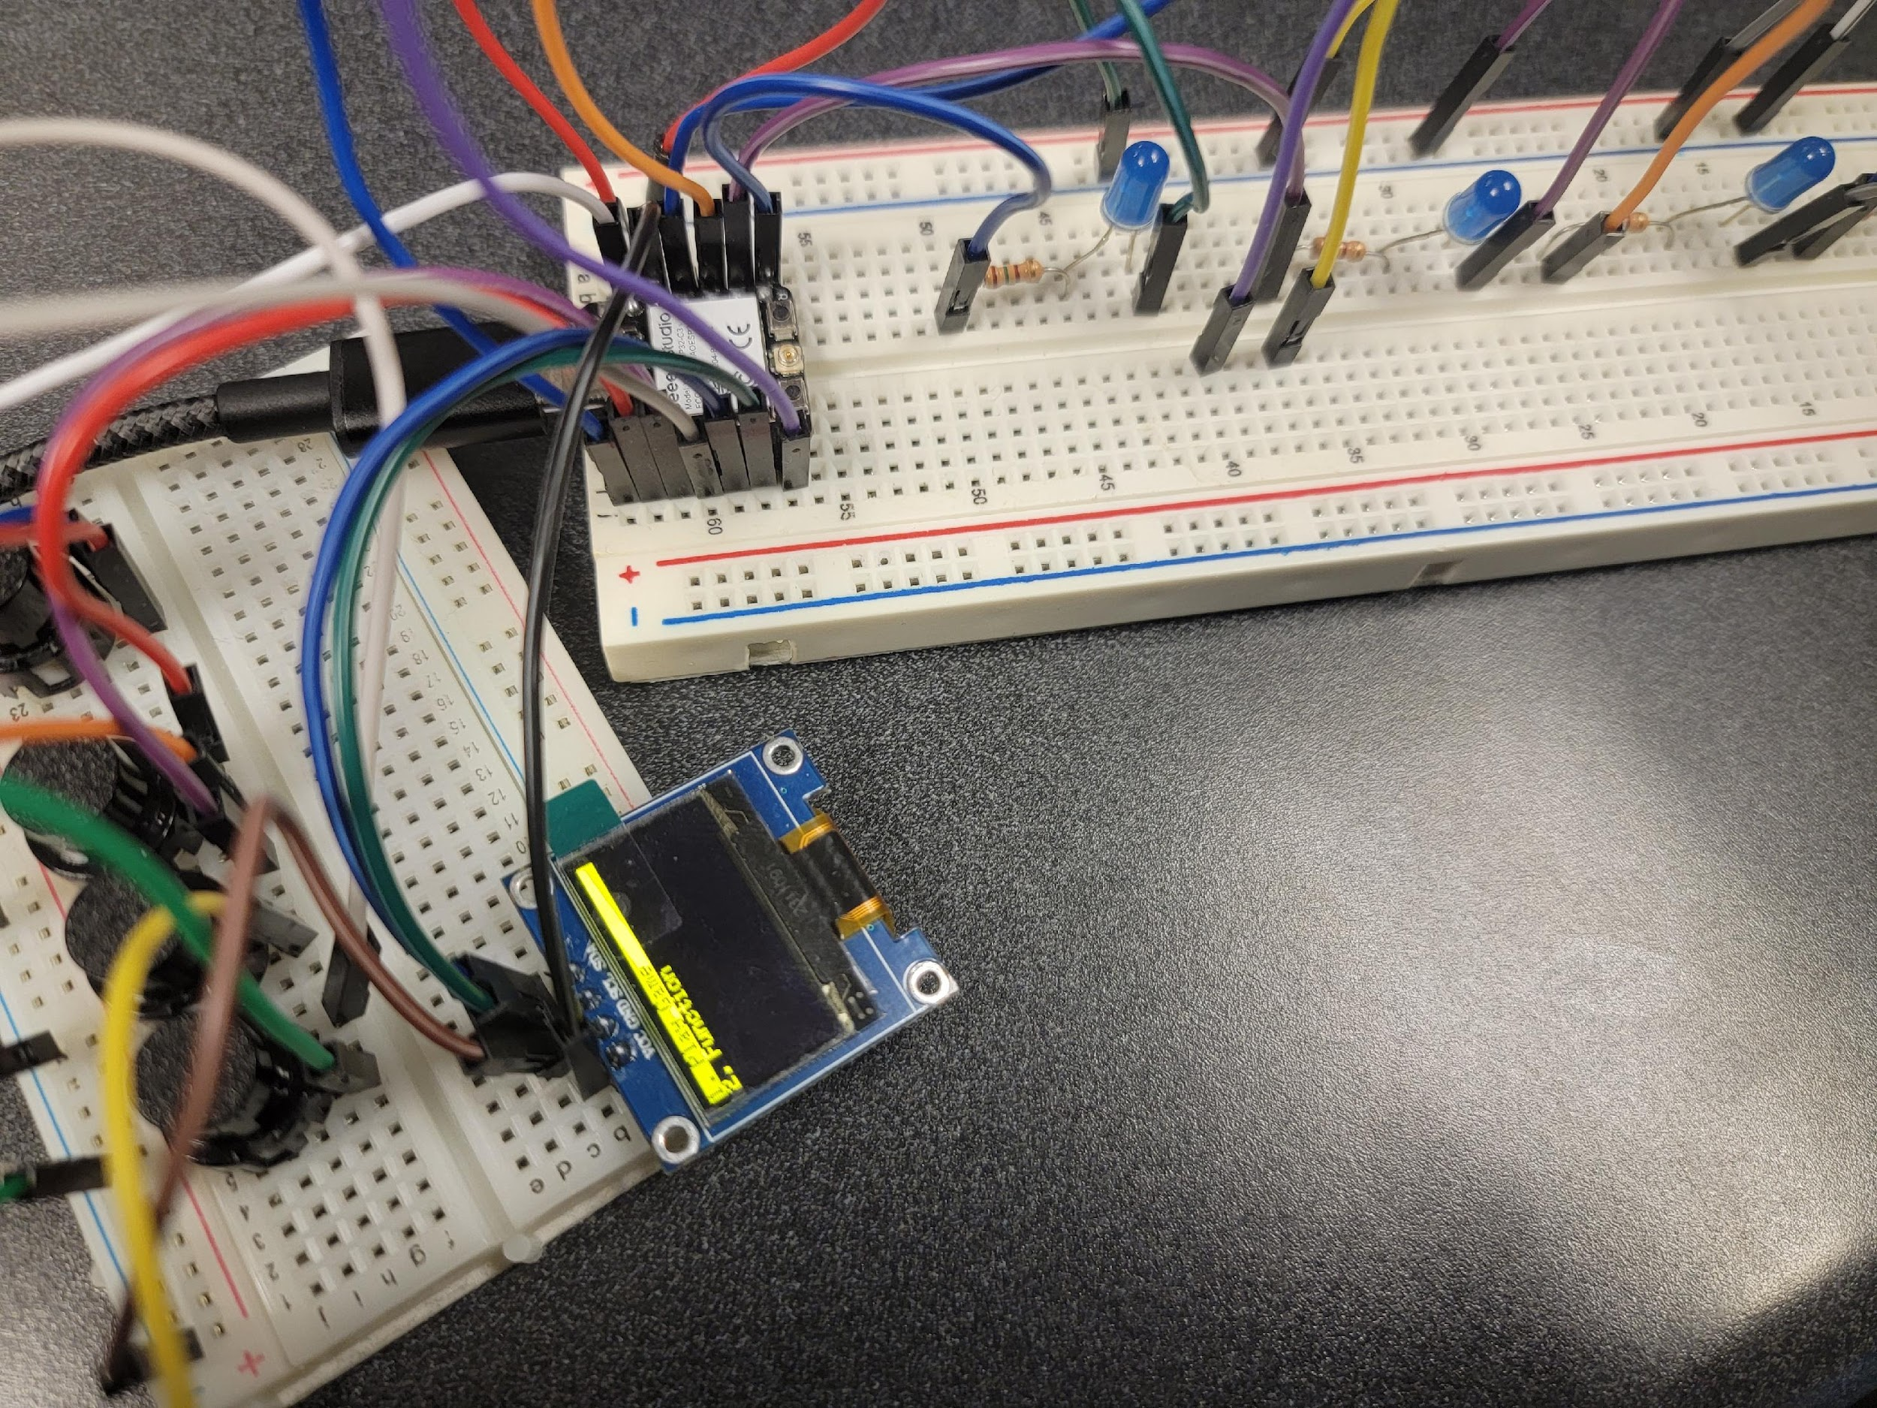
Testing
We have successfully implemented four games on the breadboard, they are Reaction Game, Jump Dino, Memory Game, Snake Game.

Slide 14
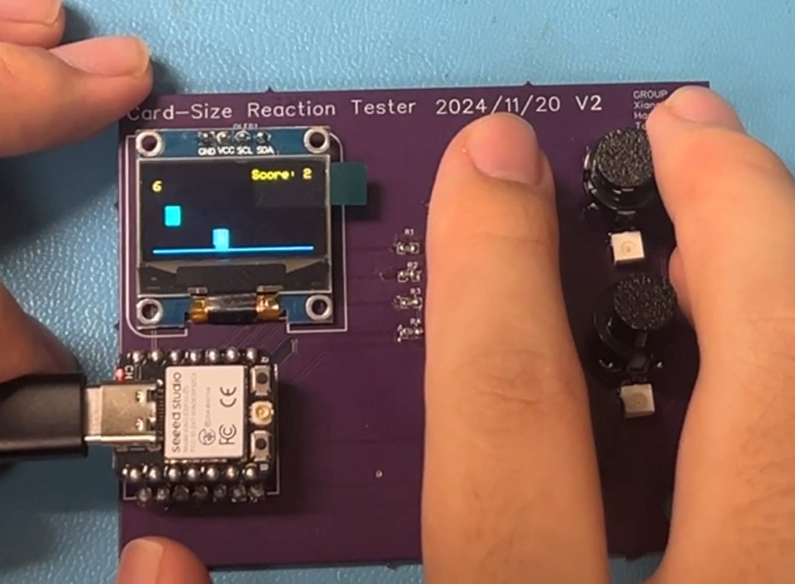
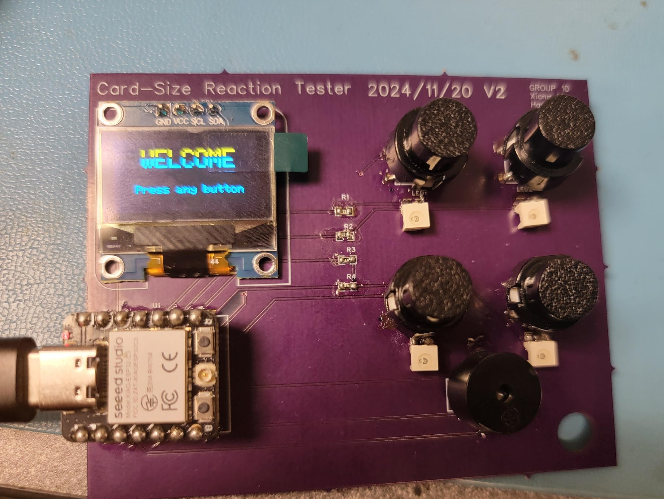
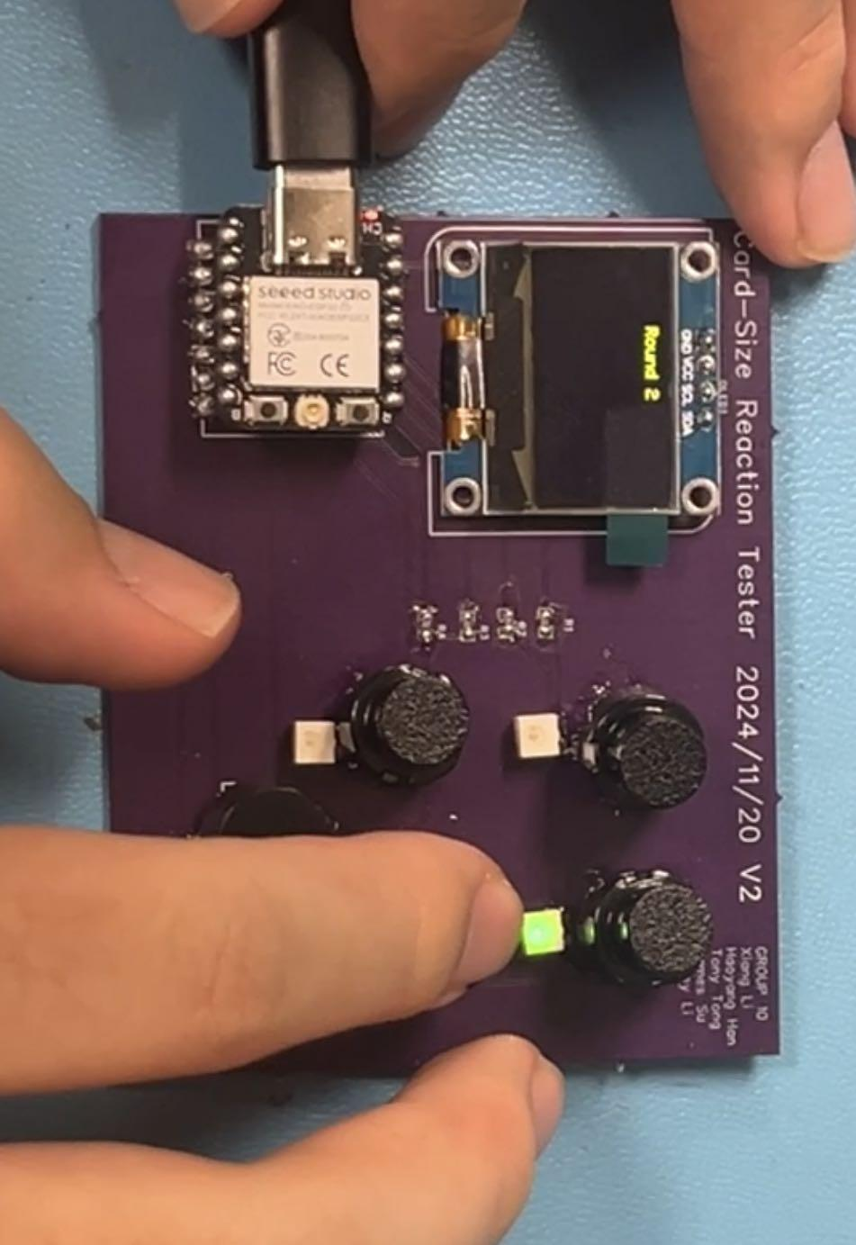
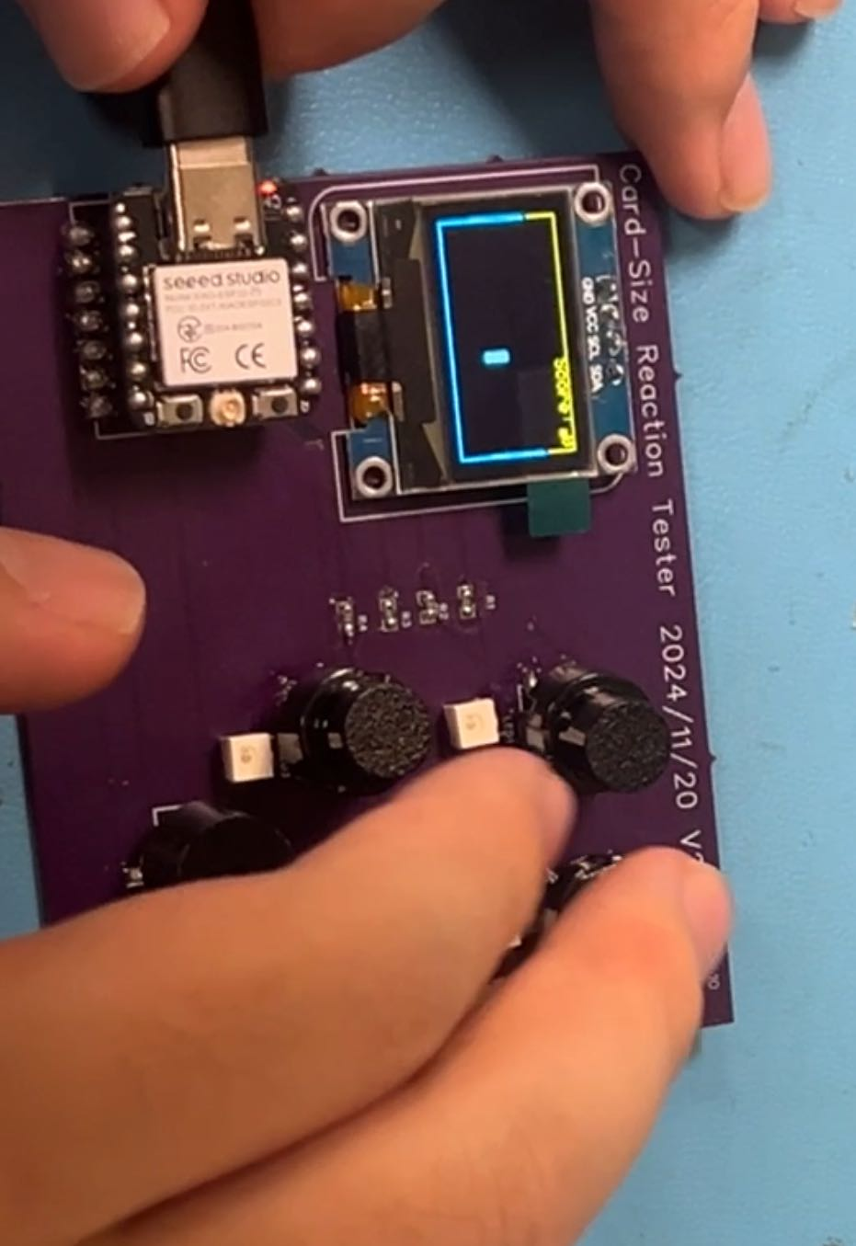
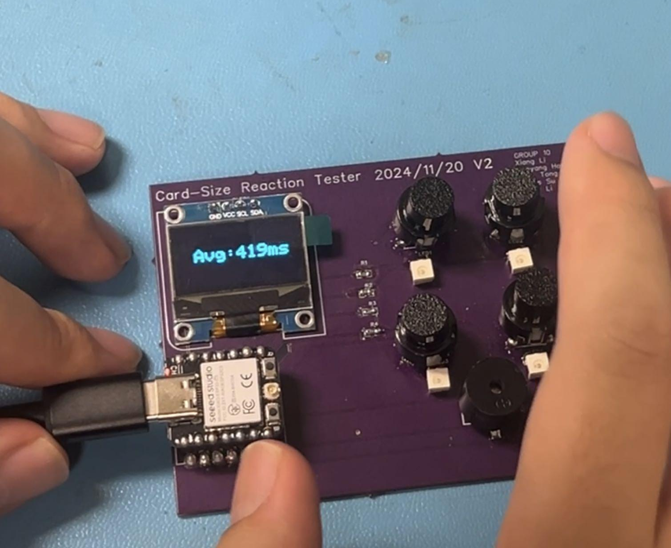
Testing
After all the mishaps as well as fixing the faults, we finally managed to get a product that was able to fulfill all the tasks.

Slide 15
Issues
The Process was really NOT SMOOTH
Lots of time Near the edge of failure

Slide 16
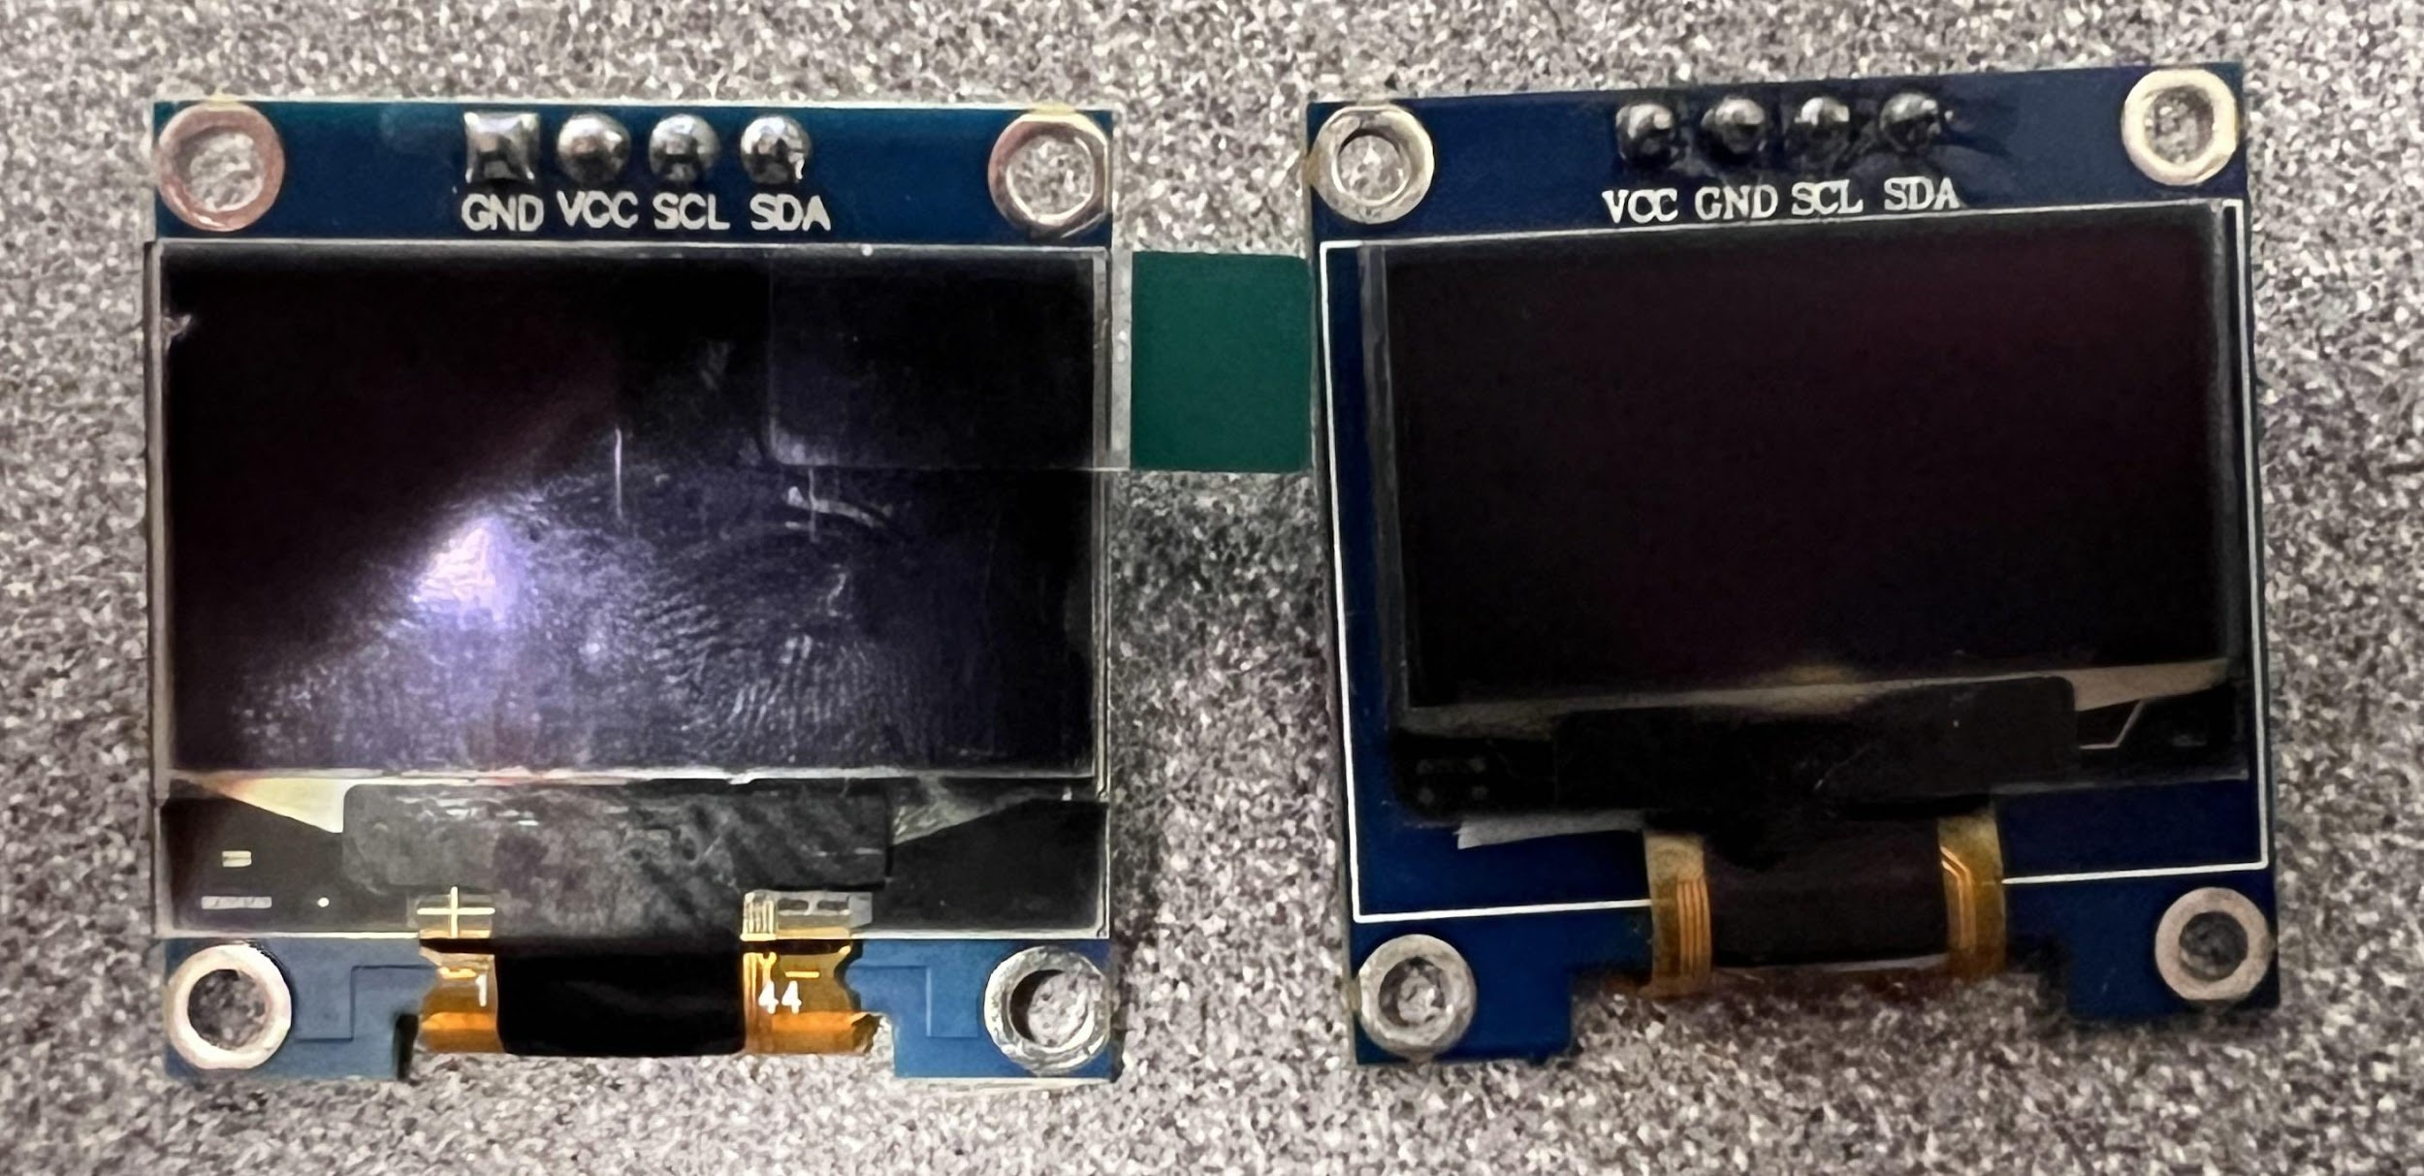
BURNED SCREEN
After completing the soldering, we tested it over and over again and the screen wouldn't work. We searched for the reason from all aspects and finally found out to our surprise:In the PCB circuit, the OLED screen has different pinout orders as the component we have. There are a lot of similar of this kind of screens out on the Market, they look the same but some have different VCC and GND pin orders. We have a mismatch on that so the first one on our PCB burns out!

Slide 17
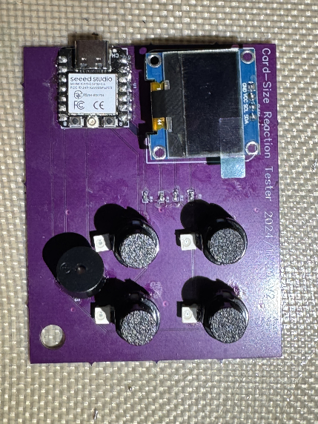
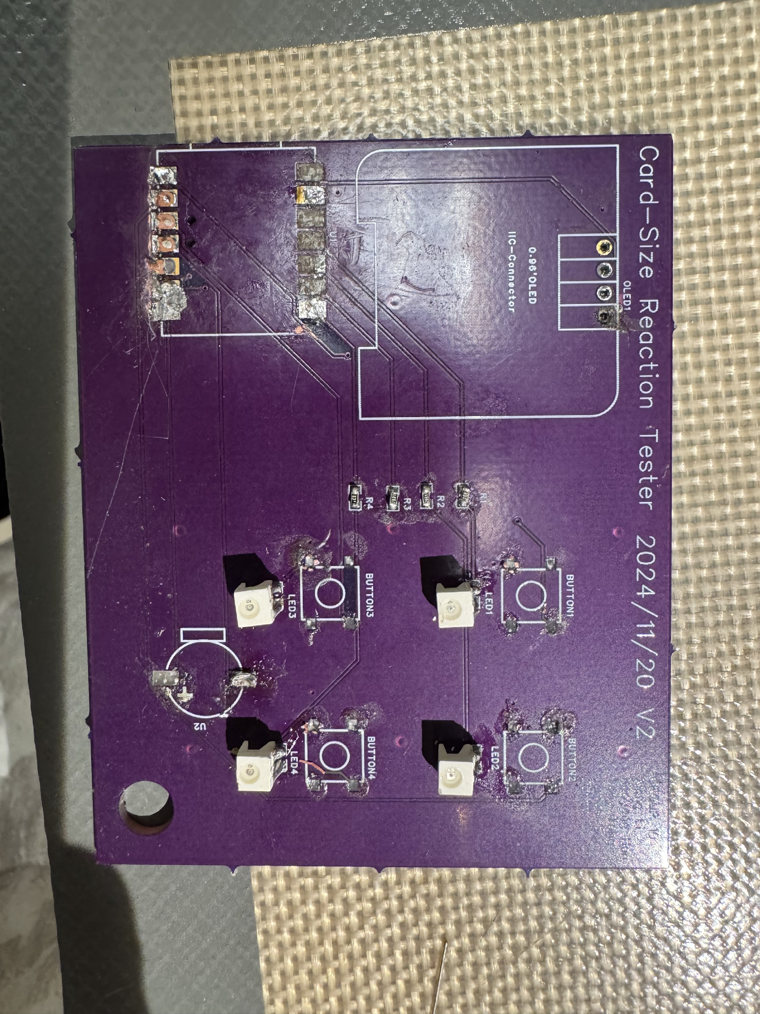
The Accident happens
Experimental accident: After replacing the screen, we accidentally dropped the board. Many components fell off, so we got a new board and re-soldered it.

Slide 18
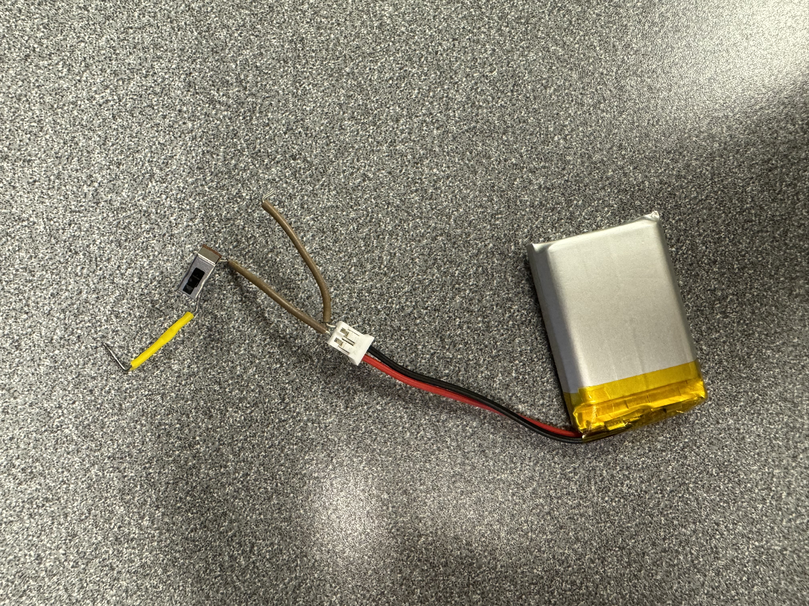
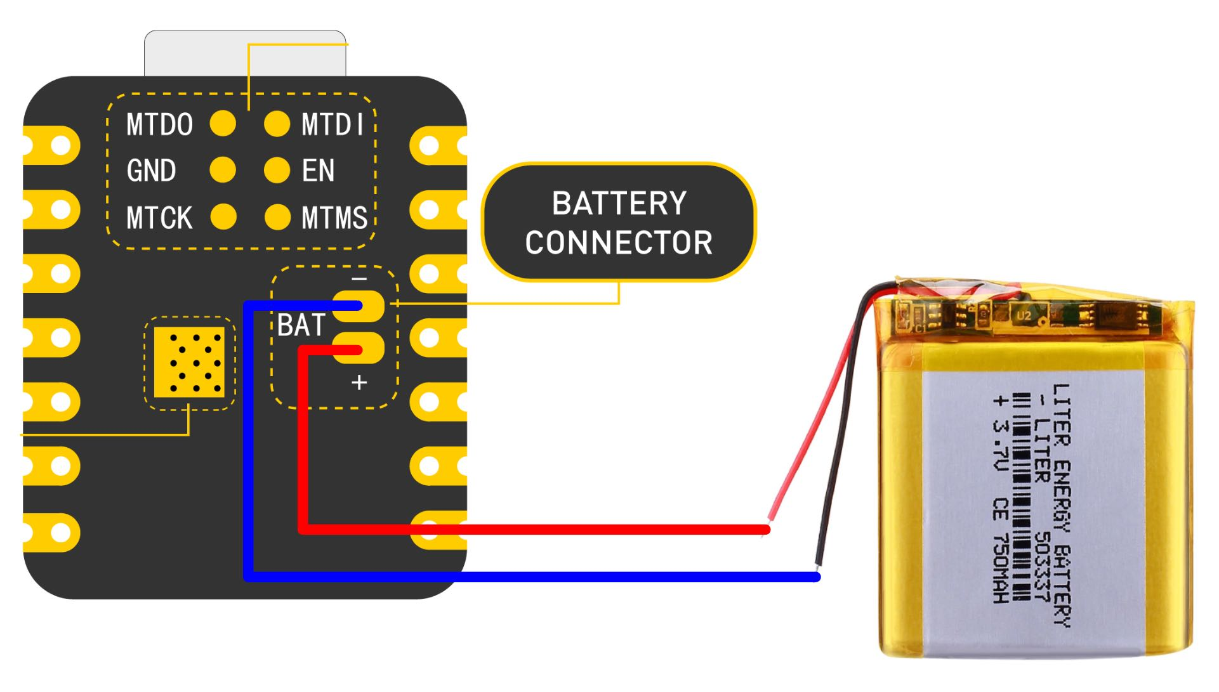
Power Supply – Board design issue
We finished the design of the battery as well as building it according to the PCB. But due to the layout of the battery's pins on the CPU is underneath the CPU, it is difficult to solder on a flat surface again. So we switched to an external power supply to achieve the same.

Slide 19
Contributions
James Su, Danny Li: First version of PDS, BOM, Functional Decomposition, Gantt chart, Test Plan, Slides
Tony Tong: 3D printing case, Hardware connection circuit design, Soldering PCB, do testing and write Slides
Haoyang Han: The designer of PCB, schematic, document writing, components selecting, Layout designer, physical prototype, contribute to slides
Xiang Li: The coder, Set up collaboration site, do breadboard testing, took part in PCB and sechematic design, the tester of the functions, contribute to slides and all documentations

Slide 20
Lessons Learned
How to work as a team
KiCAD and EasyCAD, tools to draw schematic and PCB and layout
Code and communicating with ESP32
Modeling with SolidWorks
Always be careful about choosing components
DOUBLE CHECK
Picking Components is important
PCBs are fragile and soldering needs practice

Slide 21
Thanks!
GitHub:Tokibot1/ECE-411-Group-10: Github repo for PSU ECE 411 Group 10

